Slide 1
Johnny Hooyberghs
Quantum Computing deep dive

Slide 2

Johnny Hooyberghs
@djohnnieke
github.com/Djohnnie
www.involved-it.be

Slide 3
Why Quantum Computing?

Slide 4
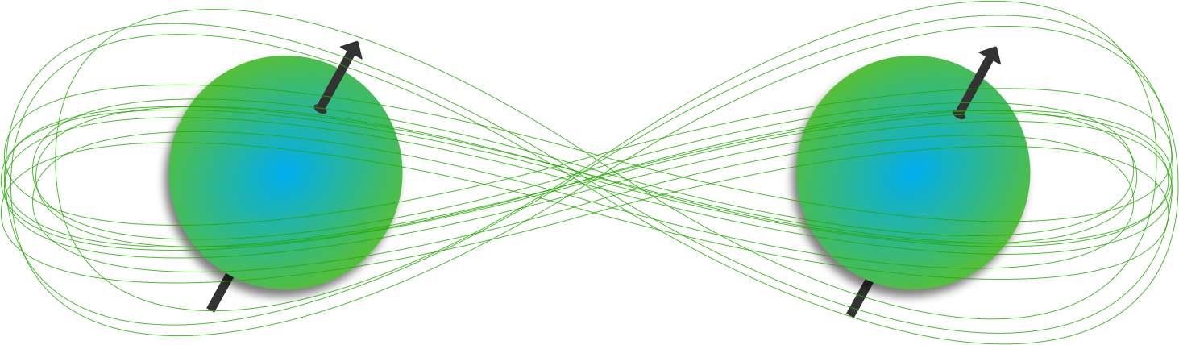
Superposition and Entanglement
Quantum Physics describes superposition and entanglement of quantum particles
Quantum Computing can use these phenomenon to its advantage

Slide 5

Double-slit Experiment

Slide 6
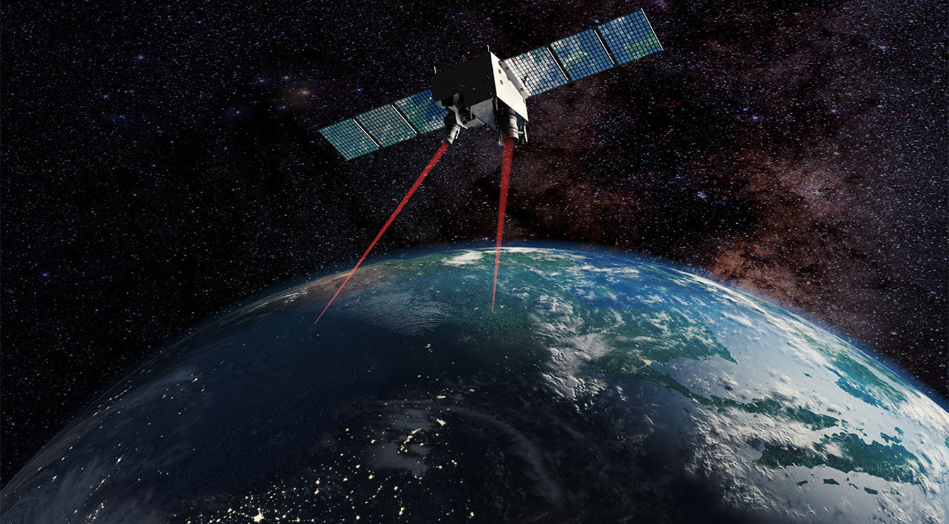
Quantum Experiments at Space Scale (QUESS)

Slide 7

Why Quantum Computing?
Security
Public/private key encryption?
Could make current RSA encryption obsolete
QKD (Quantum Key Distribution)
Lattice-based cryptography

Slide 8
Why Quantum Computing?
Drug development
It takes a quantum system to simulate a quantum system ☺
Interactions between molecules
Gene sequencing
Protein folding

Slide 9
Why Quantum Computing?
Artificial Intelligence
Analyze large quantities of data
Fast feedback
Emulate human mind

Slide 10
?

Slide 11
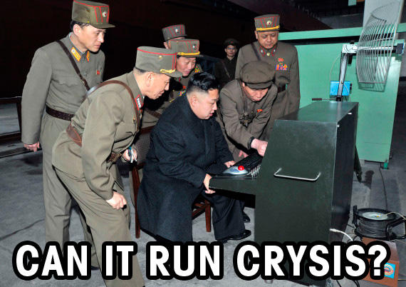

Slide 12
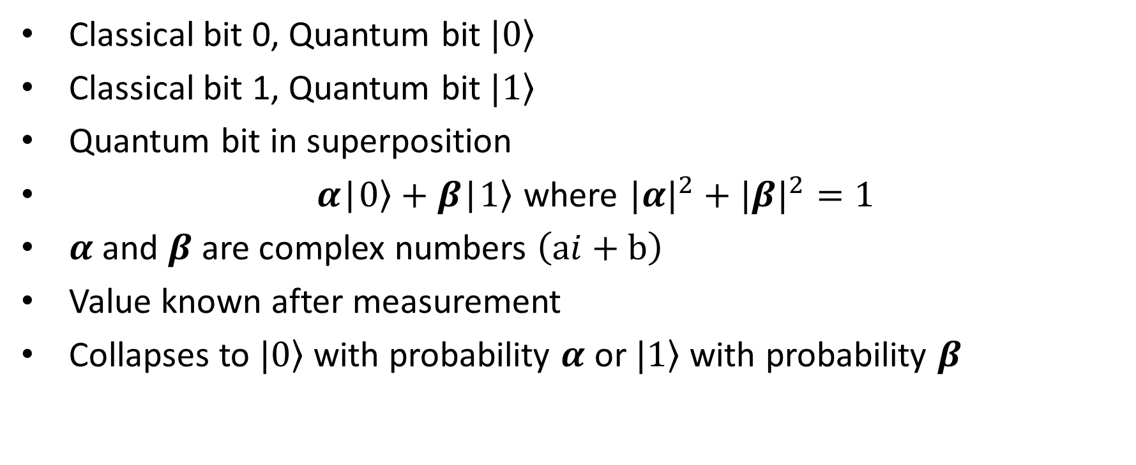
Bits vs. Qubits
Classical bit 0, Quantum bit $|\left.0\right\rangle$
Classical bit 1, Quantum bit $|\left.1\right\rangle$
Quantum bit in superposition
$α\text{|}\left.0\right\rangle +β\text{|}\left.1\right\rangle$ where ${|α|}^{2}+{|β|}^{2}=1$
𝜶 and 𝜷 are complex numbers $\left(ai+b\right)$
Value known after measurement
Collapses to $|\left.0\right\rangle$ with probability 𝜶 or $|\left.1\right\rangle$ with probability 𝜷

Slide 13
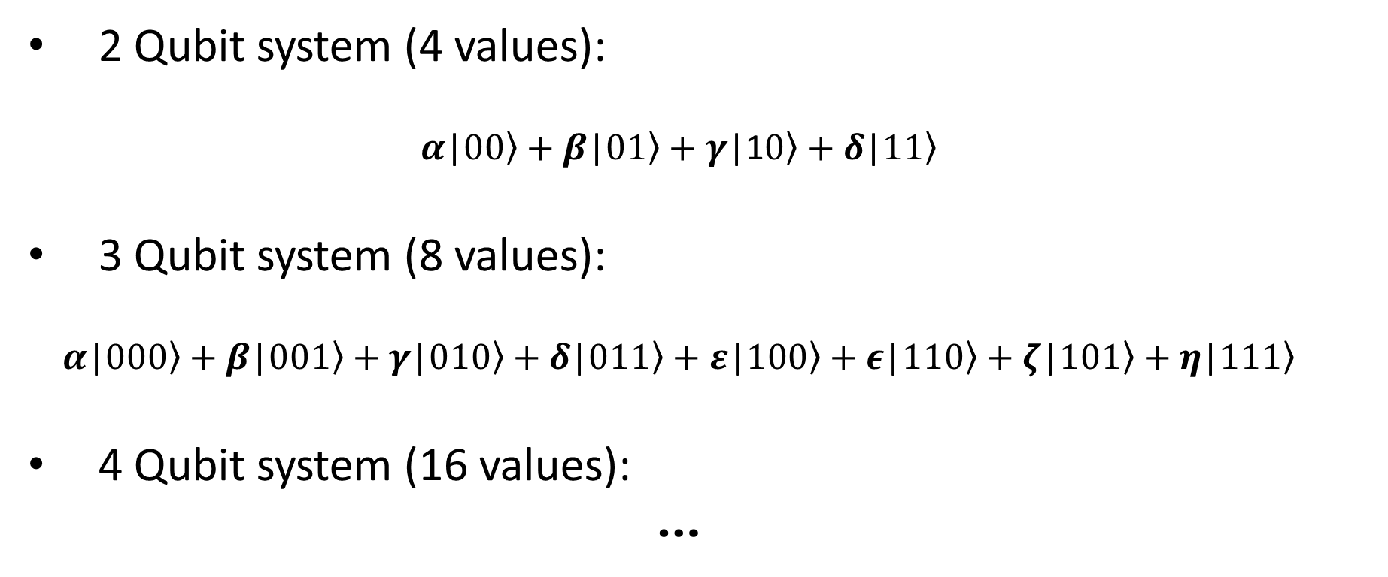
Bits vs. Qubits
2 Qubit system (4 values):
$$α\text{|}\left.00\right\rangle +β\text{|}0\left.1\right\rangle +γ\text{|1}\left.0\right\rangle +δ\text{|}\left.11\right\rangle$$
3 Qubit system (8 values):
$$α\text{|}\left.000\right\rangle +β\text{|}00\left.1\right\rangle +γ\text{|}\left.010\right\rangle +δ\text{|}\left.011\right\rangle +ε\text{|}\left.100\right\rangle +ε\text{|}\left.110\right\rangle +ζ\text{|}\left.101\right\rangle +η\text{|}\left.111\right\rangle$$
4 Qubit system (16 values):
…

Slide 14

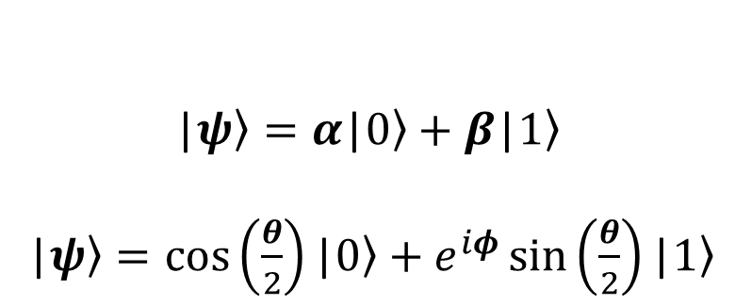
Bits vs. Qubits
$$\text{|}\left.ψ\right\rangle =α\text{|}\left.0\right\rangle +β\text{|}\left.1\right\rangle$$
$\text{|}\left.ψ\right\rangle =\cos\left(\frac{θ}{2}\right)\text{|}\left.0\right\rangle +e^{iφ}\sin\left(\frac{θ}{2}\right)\text{|}\left.1\right\rangle$

Slide 15

IBM Q Experience
https://quantum-computing.ibm.com

Slide 16

Microsoft Q#
https://www.microsoft.com/en-us/quantum/development-kit

Slide 17

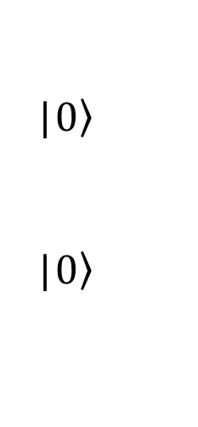
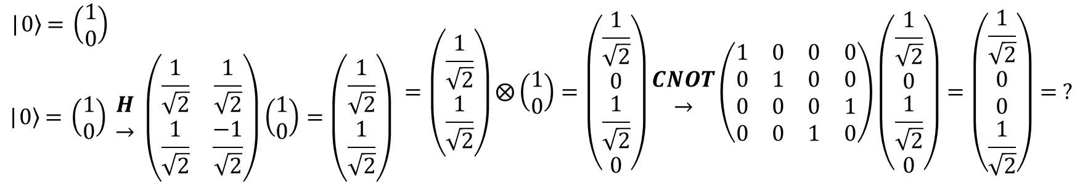
Entanglement
|$\left.0\right\rangle$
|$\left.0\right\rangle$
+
H
$$\begin{matrix}\text{|}\left.0\right\rangle \text{ = }\left(\begin{matrix}1 \\ 0\end{matrix}\right) \\ \text{|}\left.0\right\rangle \text{ = }\left(\begin{matrix}1 \\ 0\end{matrix}\right) \begin{matrix}H \\ →\end{matrix} \left(\begin{matrix}\frac{1}{\sqrt{2}} & \frac{1}{\sqrt{2}} \\ \frac{1}{\sqrt{2}} & \frac{−1}{\sqrt{2}}\end{matrix}\right)\left(\begin{matrix}1 \\ 0\end{matrix}\right)=\left(\begin{matrix}\frac{1}{\sqrt{2}} \\ \frac{1}{\sqrt{2}}\end{matrix}\right) \end{matrix}=\left(\begin{matrix}\frac{1}{\sqrt{2}} \\ \frac{1}{\sqrt{2}}\end{matrix}\right)⨂\left(\begin{matrix}1 \\ 0\end{matrix}\right)=\begin{matrix}\left(\begin{matrix}\frac{1}{\sqrt{2}} \\ 0 \\ \frac{1}{\sqrt{2}} \\ 0\end{matrix}\right)\begin{matrix}CNOT \\ →\end{matrix}\left(\begin{matrix}1 & 0 & 0 & 0 \\ 0 & 1 & 0 & 0 \\ 0 & 0 & 0 & 1 \\ 0 & 0 & 1 & 0\end{matrix}\right)\left(\begin{matrix}\frac{1}{\sqrt{2}} \\ 0 \\ \frac{1}{\sqrt{2}} \\ 0\end{matrix}\right)=\left(\begin{matrix}\frac{1}{\sqrt{2}} \\ 0 \\ 0 \\ \frac{1}{\sqrt{2}}\end{matrix}\right)\end{matrix}= ?$$

Slide 18
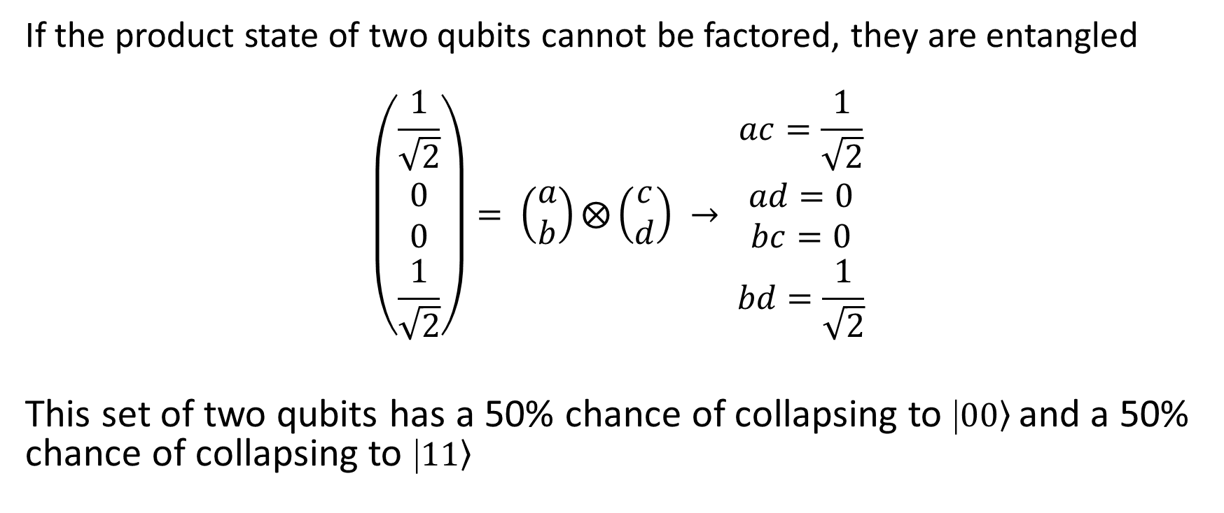
Entanglement
If the product state of two qubits cannot be factored, they are entangled
$$\left(\begin{matrix}\frac{1}{\sqrt{2}} \\ 0 \\ 0 \\ \frac{1}{\sqrt{2}}\end{matrix}\right)= \left(\begin{matrix}a \\ b\end{matrix}\right)⨂\left(\begin{matrix}c \\ d\end{matrix}\right) → \begin{matrix}ac=\frac{1}{\sqrt{2}} \\ ad=0 \\ bc=0 \\ bd=\frac{1}{\sqrt{2}}\end{matrix}$$
This set of two qubits has a 50% chance of collapsing to $\text{|}\left.00\right\rangle$and a 50% chance of collapsing to $\text{|}\left.11\right\rangle$

Slide 19
Quantum Algorithms
Deutch (1985)
Is there a problem that a Quantum Computer can solve faster than a Classical Computer?
Deterministic!
The solution is always correct after running it once!

Slide 20
Quantum Algorithms
Deutsch–Jozsa (1992)
Based on Deutch (for a blackbox operating on 1 bit), but applicable for n-bits
Deterministic!
The solution is always correct after running it once!

Slide 21
Quantum Algorithms
Grover's algorithm (1996)
“Searching a database”, actually Inverting a function: y = f(x)
Probabilistic!
High probability of finding the solution.
Running multiple times will increase the probability.

Slide 22
Quantum Algorithms
Shor's algorithm (1994)
Prime factorization of integers
Combination of classical and quantum algorithm
Probabilistic!
High probability of finding the solution.
Running multiple times will increase the probability.

Slide 23
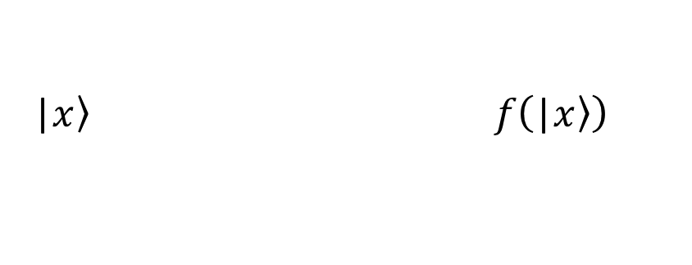
Deutsch's algorithm
Can a Quantum Computer be quicker than a Classical Computer?
A Black-Box containing a function on one bit
How many operations do you need to figure out the function if input and output is know?
On a Classical Computer?
On a Quantum Computer?
BB
|$\left.x\right\rangle f\left(\text{|}\left.x\right\rangle \right)$

Slide 24
Deutsch's algorithm
It is important to ask the right question!
A Black-Box containing a function on one bit
How many operations do you need to figure out if the function is CONSTANT or VARIABLE if input and output is know?
On a Classical Computer?
On a Quantum Computer?
BB
|$\left.x\right\rangle f\left(\text{|}\left.x\right\rangle \right)$

Slide 25
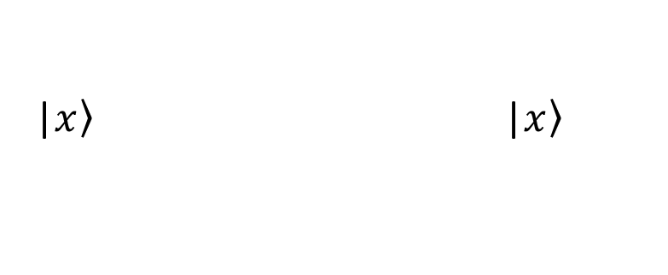
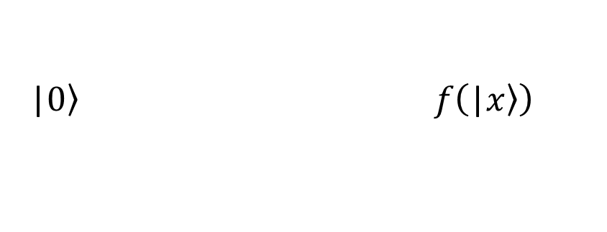
Deutsch's algorithm
It is important to ask the right question!
A Black-Box containing a function on one bit
How many operations do you need to figure out if the function is CONSTANT or VARIABLE if input and output is know?
On a Classical Computer?
On a Quantum Computer?
BB
|$\left.0\right\rangle f\left(\text{|}\left.x\right\rangle \right)$
|$\left.x\right\rangle$ |$\left.x\right\rangle$

Slide 26
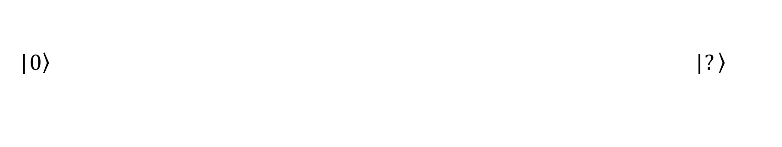
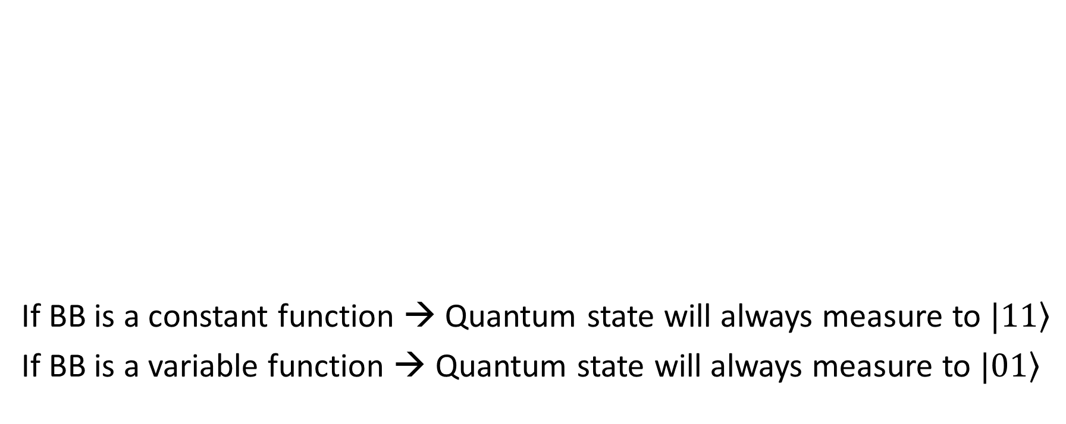
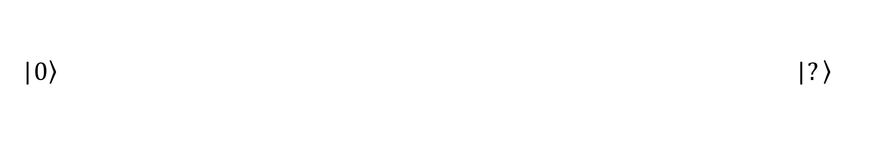
Deutsch's algorithm
If BB is a constant function → Quantum state will always measure to $\left.|11\right\rangle$
If BB is a variable function → Quantum state will always measure to $\left.|01\right\rangle$
X
H
BB
H
|$\left.0\right\rangle \text{|}\left.?\right\rangle$
|$\left.0\right\rangle$ |$\left.?\right\rangle$
X
H
H

Slide 27
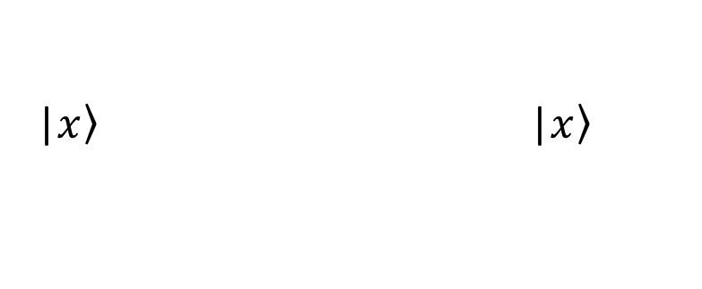
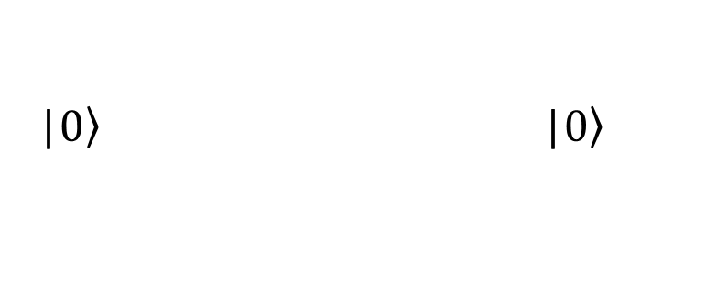
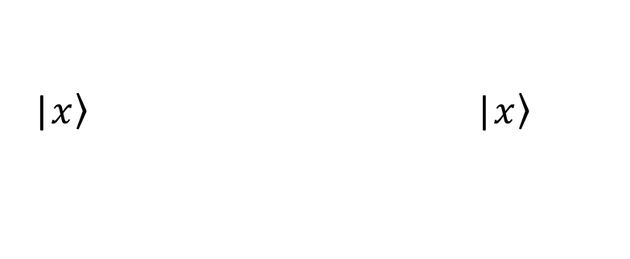
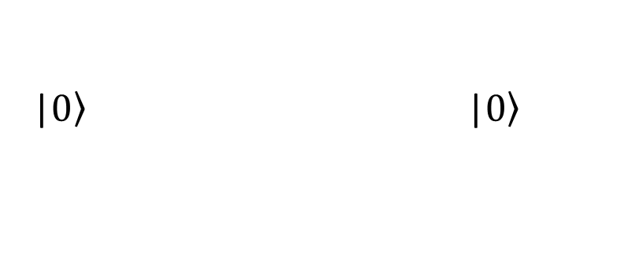
Deutsch's algorithm
Constant-0
BB
|$\left.0\right\rangle \text{|}\left.0\right\rangle$
|$\left.0\right\rangle \text{|}\left.0\right\rangle$
|$\left.x\right\rangle$ |$\left.x\right\rangle$
|$\left.x\right\rangle$ |$\left.x\right\rangle$

Slide 28
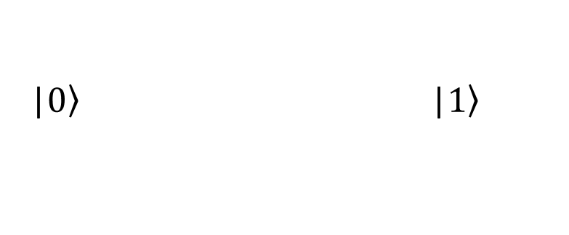
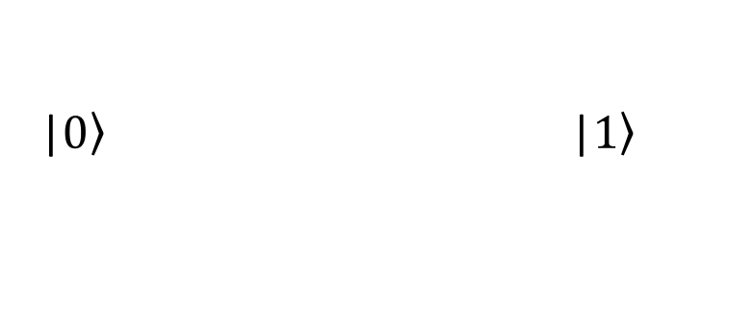
Deutsch's algorithm
Constant-1
BB
X
|$\left.0\right\rangle \text{|}\left.1\right\rangle$
|$\left.0\right\rangle \text{|}\left.1\right\rangle$
|$\left.x\right\rangle$ |$\left.x\right\rangle$
|$\left.x\right\rangle$ |$\left.x\right\rangle$

Slide 29
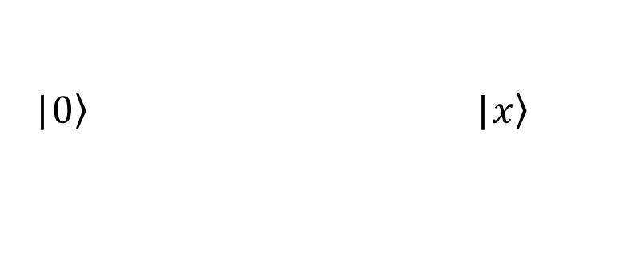
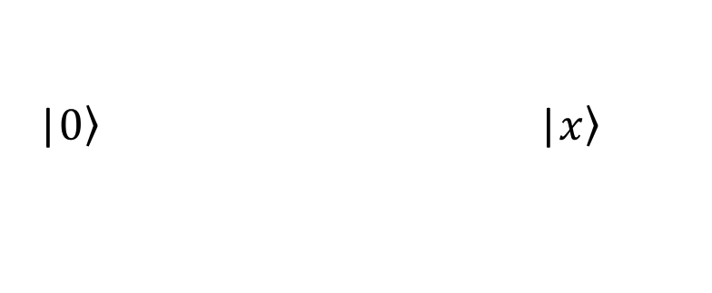
Deutsch's algorithm
Identity
BB
+
|$\left.0\right\rangle \text{|}\left.x\right\rangle$
|$\left.0\right\rangle \text{|}\left.x\right\rangle$
|$\left.x\right\rangle$ |$\left.x\right\rangle$
|$\left.x\right\rangle$ |$\left.x\right\rangle$

Slide 30
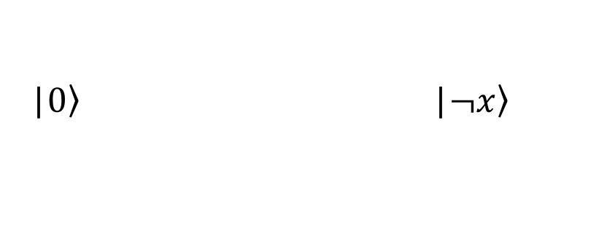
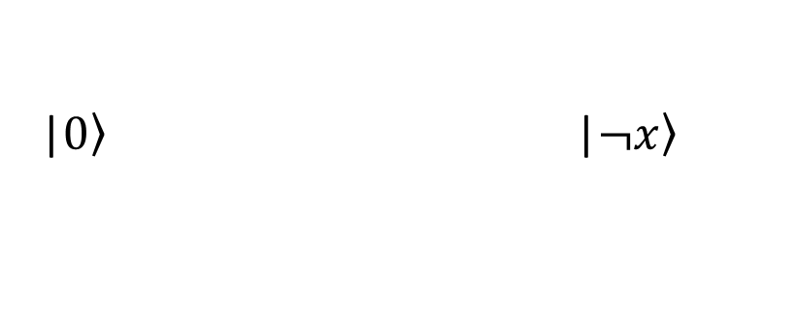
Deutsch's algorithm
Negation
BB
+
X
|$\left.0\right\rangle \text{|}\left.¬x\right\rangle$
|$\left.0\right\rangle \text{|}\left.¬x\right\rangle$
|$\left.x\right\rangle$ |$\left.x\right\rangle$
|$\left.x\right\rangle$ |$\left.x\right\rangle$

Slide 31
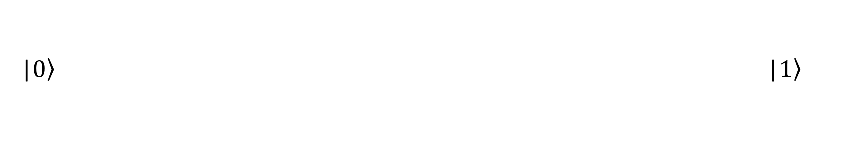
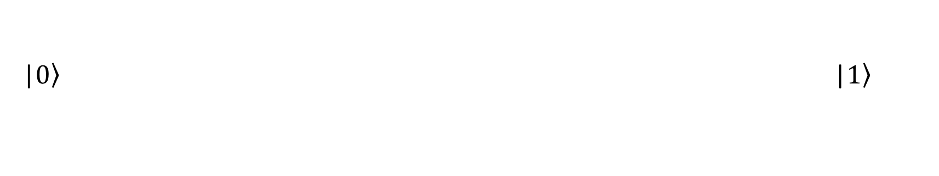
Deutsch's algorithm
Constant-0 (circuit overview)
X
H
H
|$\left.0\right\rangle \text{|}\left.1\right\rangle$
|$\left.0\right\rangle$ |$\left.1\right\rangle$
X
H
H

Slide 32
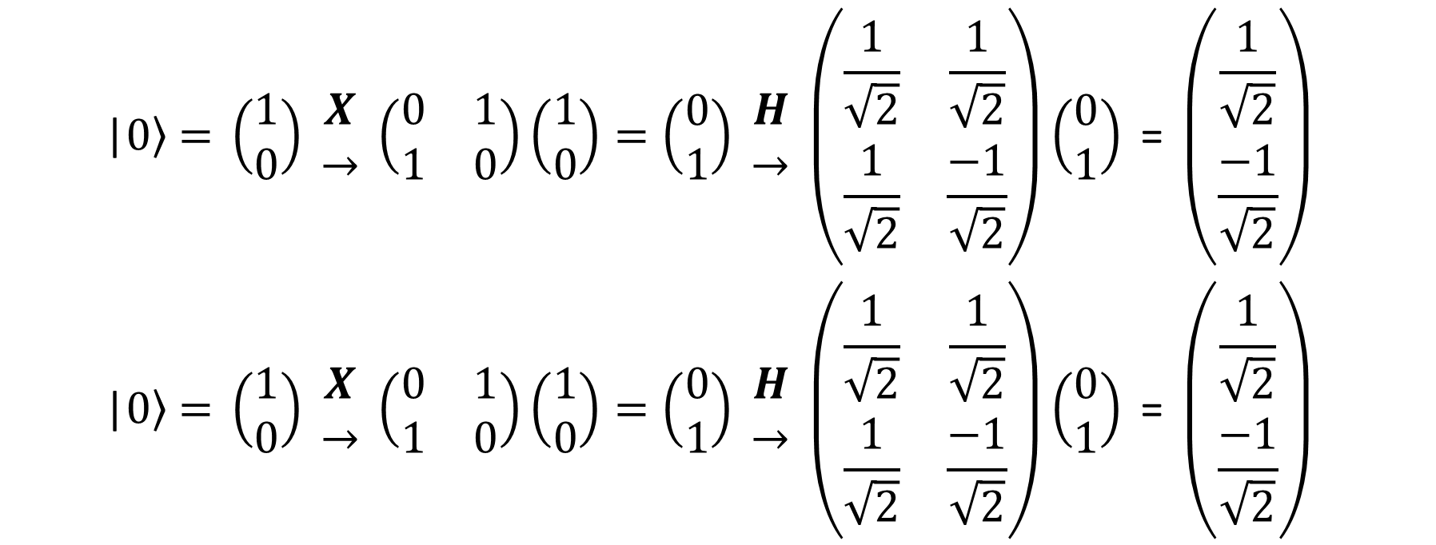
Deutsch's algorithm
Constant-0 (calculated proof – part 1)
$$\begin{matrix}\text{|}\left.0\right\rangle \text{ = }\left(\begin{matrix}1 \\ 0\end{matrix}\right) \begin{matrix}X \\ →\end{matrix} \left(\begin{matrix}0 & 1 \\ 1 & 0\end{matrix}\right)\left(\begin{matrix}1 \\ 0\end{matrix}\right)=\left(\begin{matrix}0 \\ 1\end{matrix}\right) \begin{matrix}H \\ →\end{matrix} \left(\begin{matrix}\frac{1}{\sqrt{2}} & \frac{1}{\sqrt{2}} \\ \frac{1}{\sqrt{2}} & \frac{−1}{\sqrt{2}}\end{matrix}\right)\left(\begin{matrix}0 \\ 1\end{matrix}\right)\text{ = }\left(\begin{matrix}\frac{1}{\sqrt{2}} \\ \frac{−1}{\sqrt{2}}\end{matrix}\right) \\ \text{|}\left.0\right\rangle \text{ = }\left(\begin{matrix}1 \\ 0\end{matrix}\right) \begin{matrix}X \\ →\end{matrix} \left(\begin{matrix}0 & 1 \\ 1 & 0\end{matrix}\right)\left(\begin{matrix}1 \\ 0\end{matrix}\right)=\left(\begin{matrix}0 \\ 1\end{matrix}\right) \begin{matrix}H \\ →\end{matrix} \left(\begin{matrix}\frac{1}{\sqrt{2}} & \frac{1}{\sqrt{2}} \\ \frac{1}{\sqrt{2}} & \frac{−1}{\sqrt{2}}\end{matrix}\right)\left(\begin{matrix}0 \\ 1\end{matrix}\right)\text{ = }\left(\begin{matrix}\frac{1}{\sqrt{2}} \\ \frac{−1}{\sqrt{2}}\end{matrix}\right) \end{matrix}$$

Slide 33
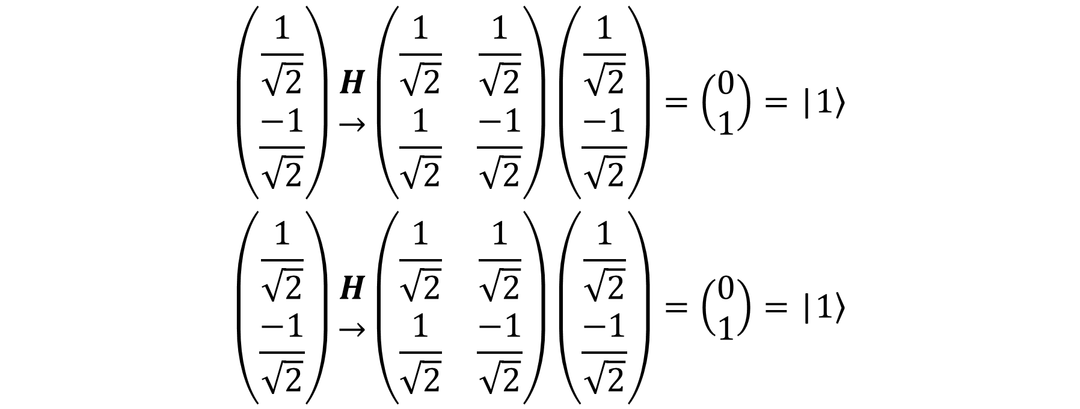
Deutsch's algorithm
Constant-0 (calculated proof – part 2)
$$\begin{matrix}\left(\begin{matrix}\frac{1}{\sqrt{2}} \\ \frac{−1}{\sqrt{2}}\end{matrix}\right)\begin{matrix}H \\ →\end{matrix}\left(\begin{matrix}\frac{1}{\sqrt{2}} & \frac{1}{\sqrt{2}} \\ \frac{1}{\sqrt{2}} & \frac{−1}{\sqrt{2}}\end{matrix}\right)\left(\begin{matrix}\frac{1}{\sqrt{2}} \\ \frac{−1}{\sqrt{2}}\end{matrix}\right)=\left(\begin{matrix}0 \\ 1\end{matrix}\right)=\text{|}\left.1\right\rangle \\ \left(\begin{matrix}\frac{1}{\sqrt{2}} \\ \frac{−1}{\sqrt{2}}\end{matrix}\right)\begin{matrix}H \\ →\end{matrix}\left(\begin{matrix}\frac{1}{\sqrt{2}} & \frac{1}{\sqrt{2}} \\ \frac{1}{\sqrt{2}} & \frac{−1}{\sqrt{2}}\end{matrix}\right)\left(\begin{matrix}\frac{1}{\sqrt{2}} \\ \frac{−1}{\sqrt{2}}\end{matrix}\right)=\left(\begin{matrix}0 \\ 1\end{matrix}\right)=\text{|}\left.1\right\rangle \end{matrix}$$

Slide 34
Deutsch's algorithm
Constant-1 (circuit overview)
X
H
X
H
|$\left.0\right\rangle \text{|}\left.1\right\rangle$
|$\left.0\right\rangle$ |$\left.1\right\rangle$
X
H
H

Slide 35
Deutsch's algorithm
Constant-1 (calculated proof – part 1)
$$\begin{matrix}\text{|}\left.0\right\rangle \text{ = }\left(\begin{matrix}1 \\ 0\end{matrix}\right) \begin{matrix}X \\ →\end{matrix} \left(\begin{matrix}0 & 1 \\ 1 & 0\end{matrix}\right)\left(\begin{matrix}1 \\ 0\end{matrix}\right)=\left(\begin{matrix}0 \\ 1\end{matrix}\right) \begin{matrix}H \\ →\end{matrix} \left(\begin{matrix}\frac{1}{\sqrt{2}} & \frac{1}{\sqrt{2}} \\ \frac{1}{\sqrt{2}} & \frac{−1}{\sqrt{2}}\end{matrix}\right)\left(\begin{matrix}0 \\ 1\end{matrix}\right)\text{ = }\left(\begin{matrix}\frac{1}{\sqrt{2}} \\ \frac{−1}{\sqrt{2}}\end{matrix}\right) \\ \text{|}\left.0\right\rangle \text{ = }\left(\begin{matrix}1 \\ 0\end{matrix}\right) \begin{matrix}X \\ →\end{matrix} \left(\begin{matrix}0 & 1 \\ 1 & 0\end{matrix}\right)\left(\begin{matrix}1 \\ 0\end{matrix}\right)=\left(\begin{matrix}0 \\ 1\end{matrix}\right) \begin{matrix}H \\ →\end{matrix} \left(\begin{matrix}\frac{1}{\sqrt{2}} & \frac{1}{\sqrt{2}} \\ \frac{1}{\sqrt{2}} & \frac{−1}{\sqrt{2}}\end{matrix}\right)\left(\begin{matrix}0 \\ 1\end{matrix}\right)\text{ = }\left(\begin{matrix}\frac{1}{\sqrt{2}} \\ \frac{−1}{\sqrt{2}}\end{matrix}\right) \end{matrix}$$

Slide 36
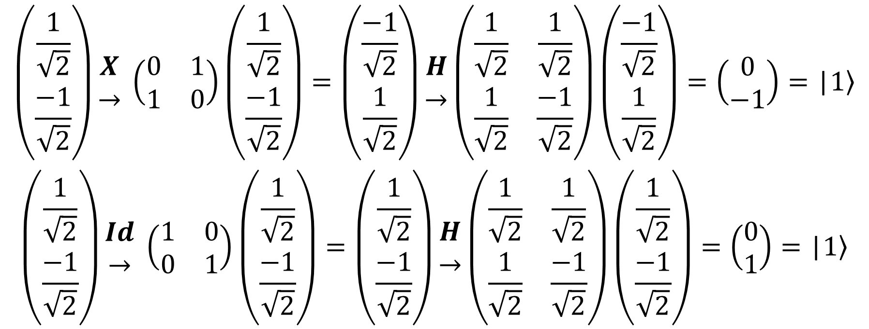
Deutsch's algorithm
Constant-1 (calculated proof – part 2)
$$\begin{matrix}\left(\begin{matrix}\frac{1}{\sqrt{2}} \\ \frac{−1}{\sqrt{2}}\end{matrix}\right)\begin{matrix}X \\ →\end{matrix} \left(\begin{matrix}0 & 1 \\ 1 & 0\end{matrix}\right)\left(\begin{matrix}\frac{1}{\sqrt{2}} \\ \frac{−1}{\sqrt{2}}\end{matrix}\right)=\left(\begin{matrix}\frac{−1}{\sqrt{2}} \\ \frac{1}{\sqrt{2}}\end{matrix}\right)\begin{matrix}H \\ →\end{matrix}\left(\begin{matrix}\frac{1}{\sqrt{2}} & \frac{1}{\sqrt{2}} \\ \frac{1}{\sqrt{2}} & \frac{−1}{\sqrt{2}}\end{matrix}\right)\left(\begin{matrix}\frac{−1}{\sqrt{2}} \\ \frac{1}{\sqrt{2}}\end{matrix}\right)=\left(\begin{matrix}0 \\ −1\end{matrix}\right)=\text{|}\left.1\right\rangle \\ \left(\begin{matrix}\frac{1}{\sqrt{2}} \\ \frac{−1}{\sqrt{2}}\end{matrix}\right)\begin{matrix}Id \\ →\end{matrix} \left(\begin{matrix}1 & 0 \\ 0 & 1\end{matrix}\right)\left(\begin{matrix}\frac{1}{\sqrt{2}} \\ \frac{−1}{\sqrt{2}}\end{matrix}\right)=\left(\begin{matrix}\frac{1}{\sqrt{2}} \\ \frac{−1}{\sqrt{2}}\end{matrix}\right)\begin{matrix}H \\ →\end{matrix}\left(\begin{matrix}\frac{1}{\sqrt{2}} & \frac{1}{\sqrt{2}} \\ \frac{1}{\sqrt{2}} & \frac{−1}{\sqrt{2}}\end{matrix}\right)\left(\begin{matrix}\frac{1}{\sqrt{2}} \\ \frac{−1}{\sqrt{2}}\end{matrix}\right)=\left(\begin{matrix}0 \\ 1\end{matrix}\right)=\text{|}\left.1\right\rangle \end{matrix}$$

Slide 37
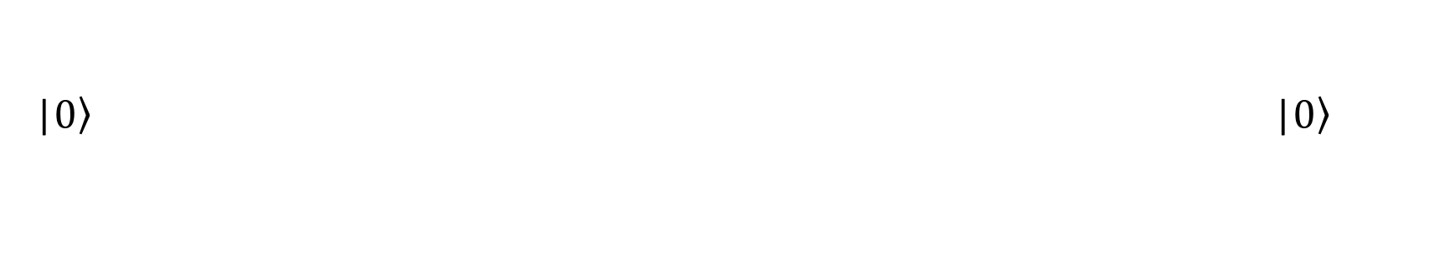
Deutsch's algorithm
Identity (circuit overview)
X
H
H
|$\left.0\right\rangle \text{|}\left.1\right\rangle$
+
|$\left.0\right\rangle$ |$\left.0\right\rangle$
X
H
H

Slide 38
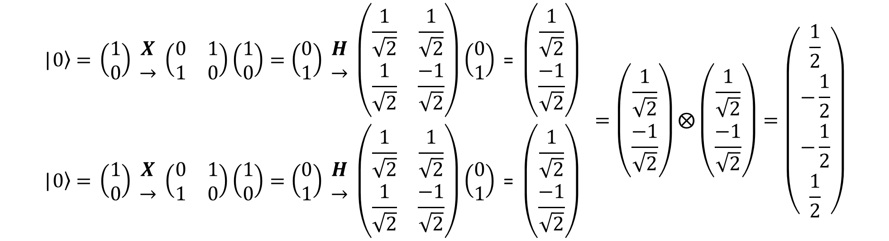
Deutsch's algorithm
Identity (calculated proof – part 1)
$$\begin{matrix}\text{|}\left.0\right\rangle \text{ = }\left(\begin{matrix}1 \\ 0\end{matrix}\right) \begin{matrix}X \\ →\end{matrix} \left(\begin{matrix}0 & 1 \\ 1 & 0\end{matrix}\right)\left(\begin{matrix}1 \\ 0\end{matrix}\right)=\left(\begin{matrix}0 \\ 1\end{matrix}\right) \begin{matrix}H \\ →\end{matrix} \left(\begin{matrix}\frac{1}{\sqrt{2}} & \frac{1}{\sqrt{2}} \\ \frac{1}{\sqrt{2}} & \frac{−1}{\sqrt{2}}\end{matrix}\right)\left(\begin{matrix}0 \\ 1\end{matrix}\right)\text{ = }\left(\begin{matrix}\frac{1}{\sqrt{2}} \\ \frac{−1}{\sqrt{2}}\end{matrix}\right) \\ \text{|}\left.0\right\rangle \text{ = }\left(\begin{matrix}1 \\ 0\end{matrix}\right) \begin{matrix}X \\ →\end{matrix} \left(\begin{matrix}0 & 1 \\ 1 & 0\end{matrix}\right)\left(\begin{matrix}1 \\ 0\end{matrix}\right)=\left(\begin{matrix}0 \\ 1\end{matrix}\right) \begin{matrix}H \\ →\end{matrix} \left(\begin{matrix}\frac{1}{\sqrt{2}} & \frac{1}{\sqrt{2}} \\ \frac{1}{\sqrt{2}} & \frac{−1}{\sqrt{2}}\end{matrix}\right)\left(\begin{matrix}0 \\ 1\end{matrix}\right)\text{ = }\left(\begin{matrix}\frac{1}{\sqrt{2}} \\ \frac{−1}{\sqrt{2}}\end{matrix}\right) \end{matrix}=\left(\begin{matrix}\frac{1}{\sqrt{2}} \\ \frac{−1}{\sqrt{2}}\end{matrix}\right)⨂\left(\begin{matrix}\frac{1}{\sqrt{2}} \\ \frac{−1}{\sqrt{2}}\end{matrix}\right)=\left(\begin{matrix}\frac{1}{2} \\ −\frac{1}{2} \\ −\frac{1}{2} \\ \frac{1}{2}\end{matrix}\right)$$

Slide 39
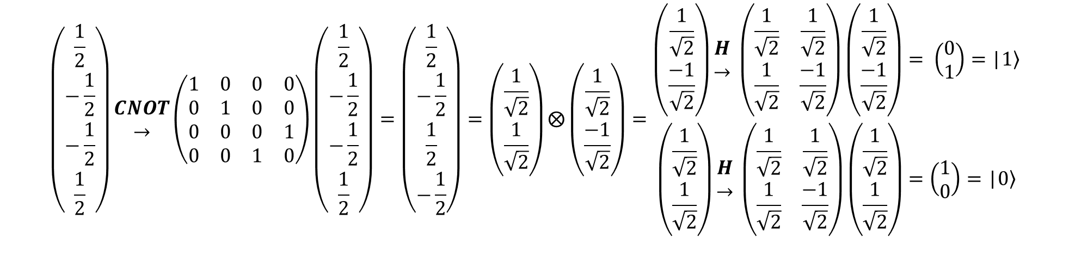
Deutsch's algorithm
Identity (calculated proof – part 2)
$$\left(\begin{matrix}\frac{1}{2} \\ −\frac{1}{2} \\ −\frac{1}{2} \\ \frac{1}{2}\end{matrix}\right)\begin{matrix}CNOT \\ →\end{matrix}\left(\begin{matrix}1 & 0 & 0 & 0 \\ 0 & 1 & 0 & 0 \\ 0 & 0 & 0 & 1 \\ 0 & 0 & 1 & 0\end{matrix}\right)\left(\begin{matrix}\frac{1}{2} \\ −\frac{1}{2} \\ −\frac{1}{2} \\ \frac{1}{2}\end{matrix}\right)=\left(\begin{matrix}\frac{1}{2} \\ −\frac{1}{2} \\ \frac{1}{2} \\ −\frac{1}{2}\end{matrix}\right)=\left(\begin{matrix}\frac{1}{\sqrt{2}} \\ \frac{1}{\sqrt{2}}\end{matrix}\right)⨂\left(\begin{matrix}\frac{1}{\sqrt{2}} \\ \frac{−1}{\sqrt{2}}\end{matrix}\right)=\begin{matrix}\left(\begin{matrix}\frac{1}{\sqrt{2}} \\ \frac{−1}{\sqrt{2}}\end{matrix}\right)\begin{matrix}H \\ →\end{matrix} \left(\begin{matrix}\frac{1}{\sqrt{2}} & \frac{1}{\sqrt{2}} \\ \frac{1}{\sqrt{2}} & \frac{−1}{\sqrt{2}}\end{matrix}\right)\left(\begin{matrix}\frac{1}{\sqrt{2}} \\ \frac{−1}{\sqrt{2}}\end{matrix}\right)= \left(\begin{matrix}0 \\ 1\end{matrix}\right)=\text{|}\left.1\right\rangle \\ \left(\begin{matrix}\frac{1}{\sqrt{2}} \\ \frac{1}{\sqrt{2}}\end{matrix}\right)\begin{matrix}H \\ →\end{matrix} \left(\begin{matrix}\frac{1}{\sqrt{2}} & \frac{1}{\sqrt{2}} \\ \frac{1}{\sqrt{2}} & \frac{−1}{\sqrt{2}}\end{matrix}\right)\left(\begin{matrix}\frac{1}{\sqrt{2}} \\ \frac{1}{\sqrt{2}}\end{matrix}\right)=\left(\begin{matrix}1 \\ 0\end{matrix}\right)=\text{|}\left.0\right\rangle \end{matrix}$$

Slide 40
Deutsch's algorithm
Negation (circuit overview)
X
H
X
H
|$\left.0\right\rangle \text{|}\left.1\right\rangle$
+
|$\left.0\right\rangle$ |$\left.0\right\rangle$
X
H
H

Slide 41
Deutsch's algorithm
Negation (calculated proof – part 1)
$$\begin{matrix}\text{|}\left.0\right\rangle \text{ = }\left(\begin{matrix}1 \\ 0\end{matrix}\right) \begin{matrix}X \\ →\end{matrix} \left(\begin{matrix}0 & 1 \\ 1 & 0\end{matrix}\right)\left(\begin{matrix}1 \\ 0\end{matrix}\right)=\left(\begin{matrix}0 \\ 1\end{matrix}\right) \begin{matrix}H \\ →\end{matrix} \left(\begin{matrix}\frac{1}{\sqrt{2}} & \frac{1}{\sqrt{2}} \\ \frac{1}{\sqrt{2}} & \frac{−1}{\sqrt{2}}\end{matrix}\right)\left(\begin{matrix}0 \\ 1\end{matrix}\right)\text{ = }\left(\begin{matrix}\frac{1}{\sqrt{2}} \\ \frac{−1}{\sqrt{2}}\end{matrix}\right) \\ \text{|}\left.0\right\rangle \text{ = }\left(\begin{matrix}1 \\ 0\end{matrix}\right) \begin{matrix}X \\ →\end{matrix} \left(\begin{matrix}0 & 1 \\ 1 & 0\end{matrix}\right)\left(\begin{matrix}1 \\ 0\end{matrix}\right)=\left(\begin{matrix}0 \\ 1\end{matrix}\right) \begin{matrix}H \\ →\end{matrix} \left(\begin{matrix}\frac{1}{\sqrt{2}} & \frac{1}{\sqrt{2}} \\ \frac{1}{\sqrt{2}} & \frac{−1}{\sqrt{2}}\end{matrix}\right)\left(\begin{matrix}0 \\ 1\end{matrix}\right)\text{ = }\left(\begin{matrix}\frac{1}{\sqrt{2}} \\ \frac{−1}{\sqrt{2}}\end{matrix}\right) \end{matrix}=\left(\begin{matrix}\frac{1}{\sqrt{2}} \\ \frac{−1}{\sqrt{2}}\end{matrix}\right)⨂\left(\begin{matrix}\frac{1}{\sqrt{2}} \\ \frac{−1}{\sqrt{2}}\end{matrix}\right)=\left(\begin{matrix}\frac{1}{2} \\ −\frac{1}{2} \\ −\frac{1}{2} \\ \frac{1}{2}\end{matrix}\right)$$

Slide 42
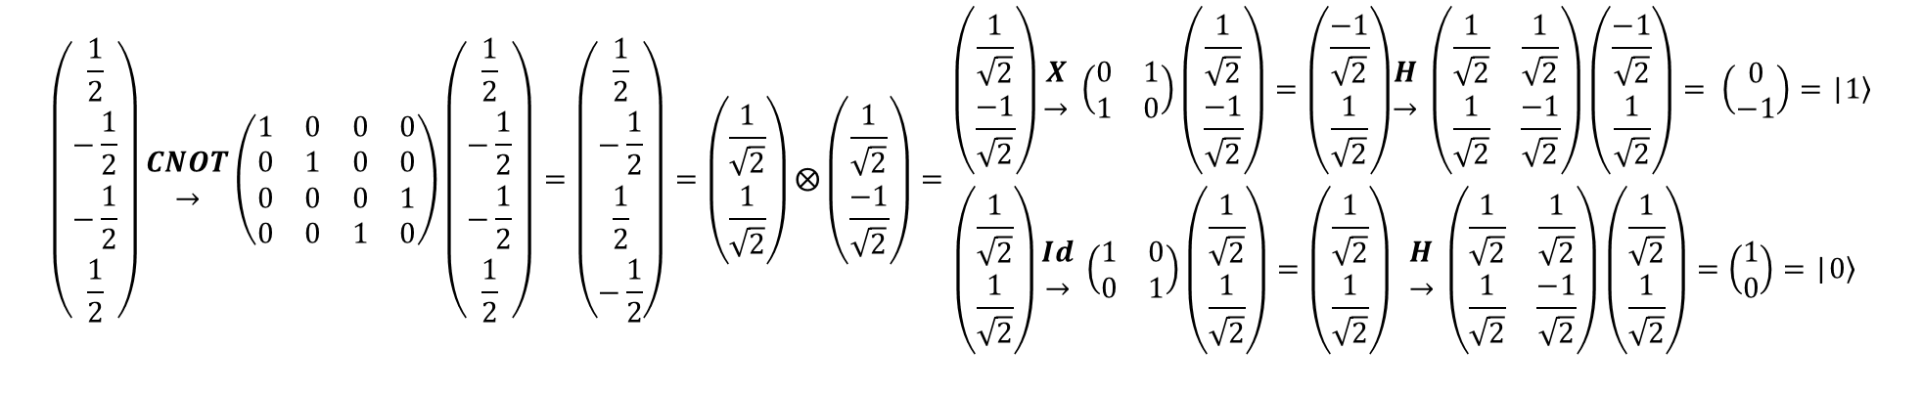
Deutsch's algorithm
Negation (calculated proof – part 2)
$$\left(\begin{matrix}\frac{1}{2} \\ −\frac{1}{2} \\ −\frac{1}{2} \\ \frac{1}{2}\end{matrix}\right)\begin{matrix}CNOT \\ →\end{matrix}\left(\begin{matrix}1 & 0 & 0 & 0 \\ 0 & 1 & 0 & 0 \\ 0 & 0 & 0 & 1 \\ 0 & 0 & 1 & 0\end{matrix}\right)\left(\begin{matrix}\frac{1}{2} \\ −\frac{1}{2} \\ −\frac{1}{2} \\ \frac{1}{2}\end{matrix}\right)=\left(\begin{matrix}\frac{1}{2} \\ −\frac{1}{2} \\ \frac{1}{2} \\ −\frac{1}{2}\end{matrix}\right)=\left(\begin{matrix}\frac{1}{\sqrt{2}} \\ \frac{1}{\sqrt{2}}\end{matrix}\right)⨂\left(\begin{matrix}\frac{1}{\sqrt{2}} \\ \frac{−1}{\sqrt{2}}\end{matrix}\right)=\begin{matrix}\left(\begin{matrix}\frac{1}{\sqrt{2}} \\ \frac{−1}{\sqrt{2}}\end{matrix}\right)\begin{matrix}X \\ →\end{matrix} \left(\begin{matrix}0 & 1 \\ 1 & 0\end{matrix}\right)\left(\begin{matrix}\frac{1}{\sqrt{2}} \\ \frac{−1}{\sqrt{2}}\end{matrix}\right)=\left(\begin{matrix}\frac{−1}{\sqrt{2}} \\ \frac{1}{\sqrt{2}}\end{matrix}\right) \\ \left(\begin{matrix}\frac{1}{\sqrt{2}} \\ \frac{1}{\sqrt{2}}\end{matrix}\right)\begin{matrix}Id \\ →\end{matrix} \left(\begin{matrix}1 & 0 \\ 0 & 1\end{matrix}\right)\left(\begin{matrix}\frac{1}{\sqrt{2}} \\ \frac{1}{\sqrt{2}}\end{matrix}\right)=\left(\begin{matrix}\frac{1}{\sqrt{2}} \\ \frac{1}{\sqrt{2}}\end{matrix}\right)\end{matrix}\begin{matrix}\begin{matrix}H \\ →\end{matrix} \left(\begin{matrix}\frac{1}{\sqrt{2}} & \frac{1}{\sqrt{2}} \\ \frac{1}{\sqrt{2}} & \frac{−1}{\sqrt{2}}\end{matrix}\right)\left(\begin{matrix}\frac{−1}{\sqrt{2}} \\ \frac{1}{\sqrt{2}}\end{matrix}\right)= \left(\begin{matrix}0 \\ −1\end{matrix}\right)=\text{|}\left.1\right\rangle \\ \begin{matrix}H \\ →\end{matrix} \left(\begin{matrix}\frac{1}{\sqrt{2}} & \frac{1}{\sqrt{2}} \\ \frac{1}{\sqrt{2}} & \frac{−1}{\sqrt{2}}\end{matrix}\right)\left(\begin{matrix}\frac{1}{\sqrt{2}} \\ \frac{1}{\sqrt{2}}\end{matrix}\right)=\left(\begin{matrix}1 \\ 0\end{matrix}\right)=\text{|}\left.0\right\rangle \end{matrix}$$

Slide 43

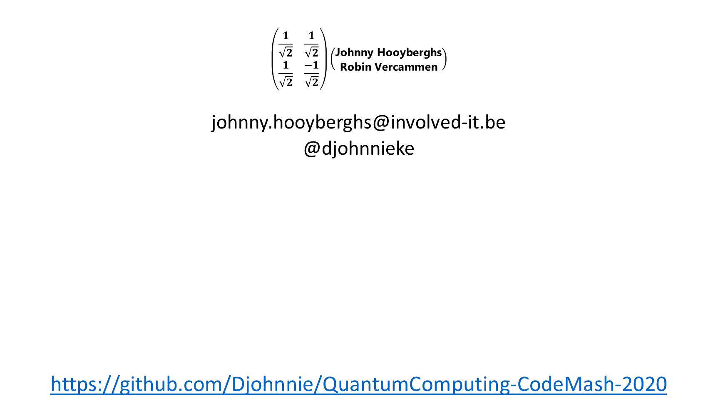
$$\left(\begin{matrix}\frac{1}{\sqrt{2}} & \frac{1}{\sqrt{2}} \\ \frac{1}{\sqrt{2}} & \frac{−1}{\sqrt{2}}\end{matrix}\right)\left(\begin{matrix}\text{Johnny} \text{Hooyberghs} \\ \text{Robin} \text{Vercammen}\end{matrix}\right)$$
johnny.hooyberghs@involved-it.be
@djohnnieke
https://github.com/Djohnnie/QuantumComputing-CodeMash-2020

